Slide 1

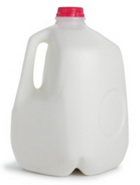
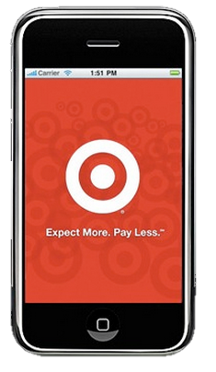
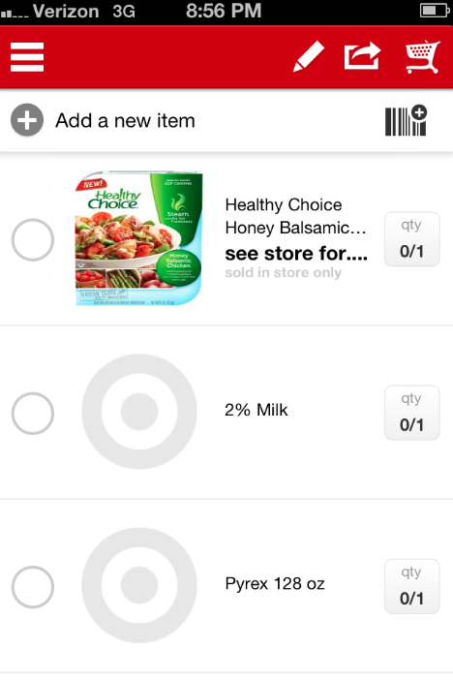
The Adaptive Shopper List App
Got Milk? We have all wondered “Do I have milk?” in the dairy section of Target. As Jerry Seinfeld illustrates in the accompanying clip, we wonder if we were out of milk? …or laundry detergent? …or cereal? We have our lists but what good are those lists anyway?
The Adaptive Shopper List App is different. Current shopping list apps are static and represent only a collection of items. By combining existing Target shopper data with customer purchase periodicity, the Adaptive Shopper List App learns the shopping habits of a consumer through scanned receipts and informs when they are ‘out of milk.’
The Adaptive Shopper List App provides a uniquely customized in store shopping experience by creating an interactive list for each consumer. The App can be developed separately or added to the current Target App.
Current Target App
Adaptive Shopper
Color coded for easy use:
Buy Now:
Buy Soon:
Don’t Buy:
Using Target product periodicity data with the last purchase date, App calculates when user will need to repurchase and adds item to the list.
4/16/13: 14 Days
4/1/13: 30 Days
User/App Limitations:
User has to scan receipts or UPC to build shopping history data.
Initial averages may not be accurate for the user.
Only works with Target receipts and may not be able to gather full buying behavior.
Difficulty to scanning UPC/Receipt
Target Benefits:
Drives customers to repeat purchases.
Improves customer shopping experience.
Target has periodicity purchasing data.
Integrate into current TargetLists feature.
Possible e-commerce extension to automatically reorder consumables.

Slide 2
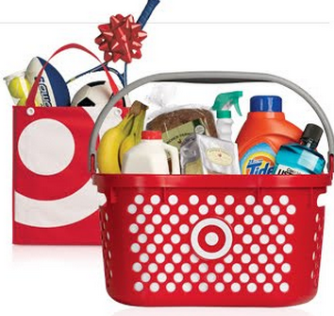
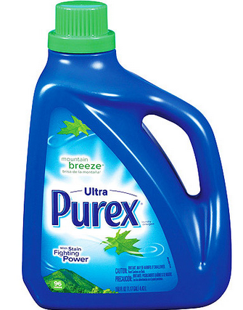
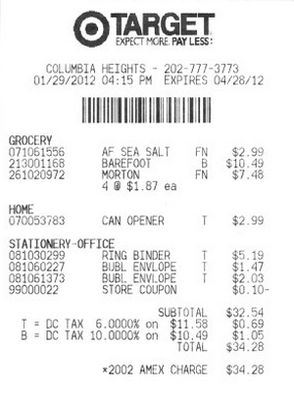
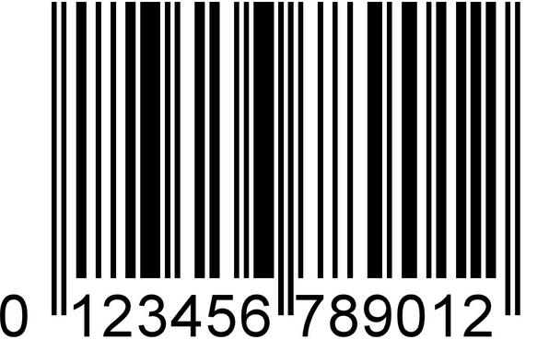

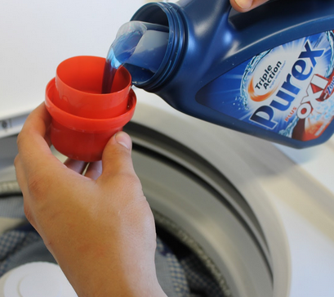
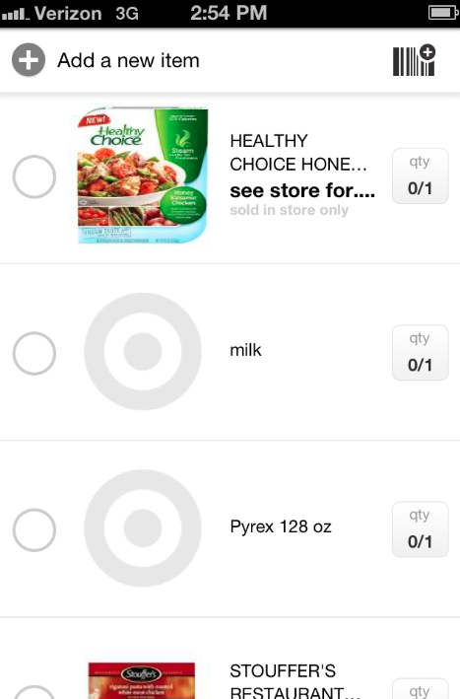


The Adaptive Shopper List App User Experience
Shopping Process:
User Action:
Purex Example:
1. App is installed with basic user information: age, location, household, etc. User shops at Target.
2. User scans UPC/receipt of Target purchases to establish base shopping list. App uses Target data for periodicity.
3. As time passes, the app assess product periodicity of items purchased in step 2.
4. App list is updated with products purchased from Step 2 that have now been used and refills the list having ‘learned’ the customer shopping habits.
5. Customer returns to Target thereby improving the app learning curve and increasing Target sales.
By providing a convenient, efficient, and effective improvement on current shopping list apps, the Adaptive Shopper List App can personalize and improve the Target customer shopping experience.
Thank you! Created by Zach Schaefer: zachaschaefer@gmail.com

